Slide 1


Saudi Space Apps Challenge 2021
Idea Pitch Video

Slide 2
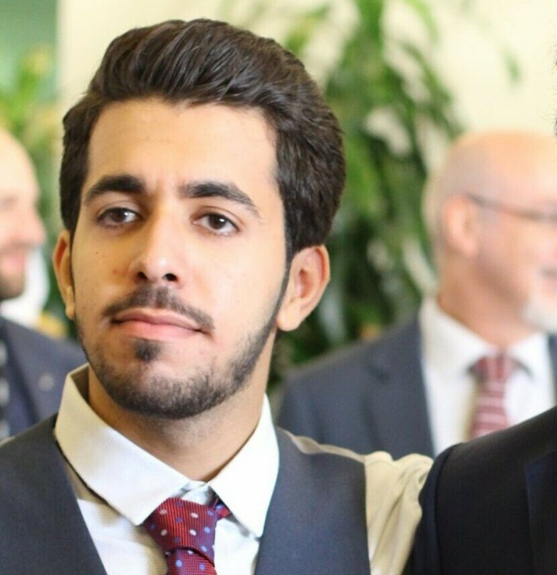
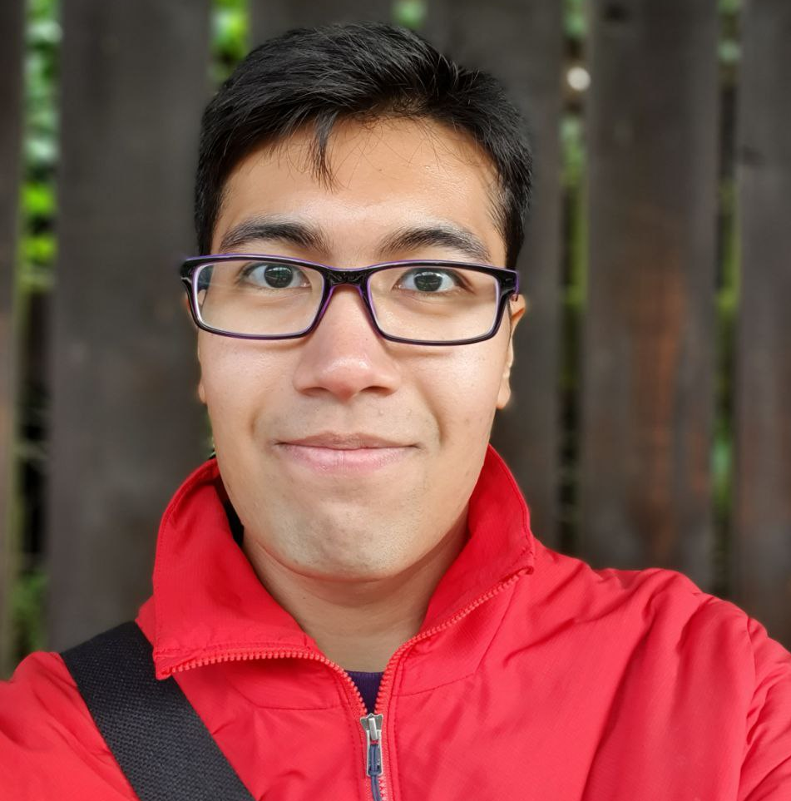

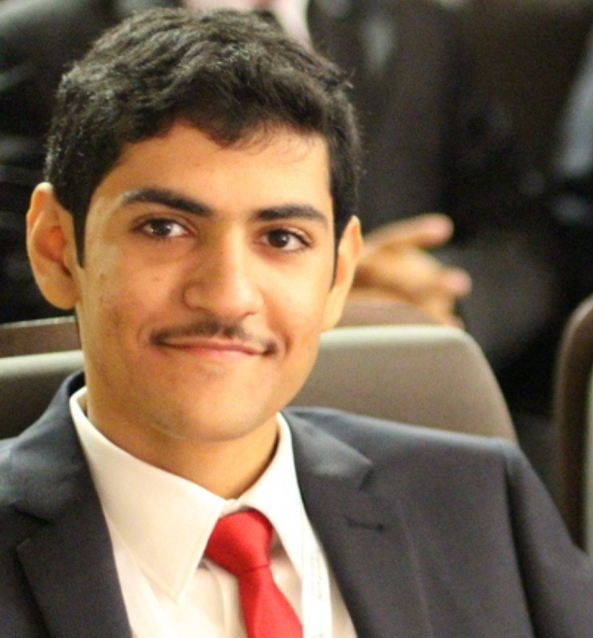
Team Reshape
Yazeed Almuqwishi
Raif Abdulrahman
Abdullah Bajkhaif
Mosaad AlThokair

Slide 3
Challenge Drones and Satellites for Urban Development

Slide 4
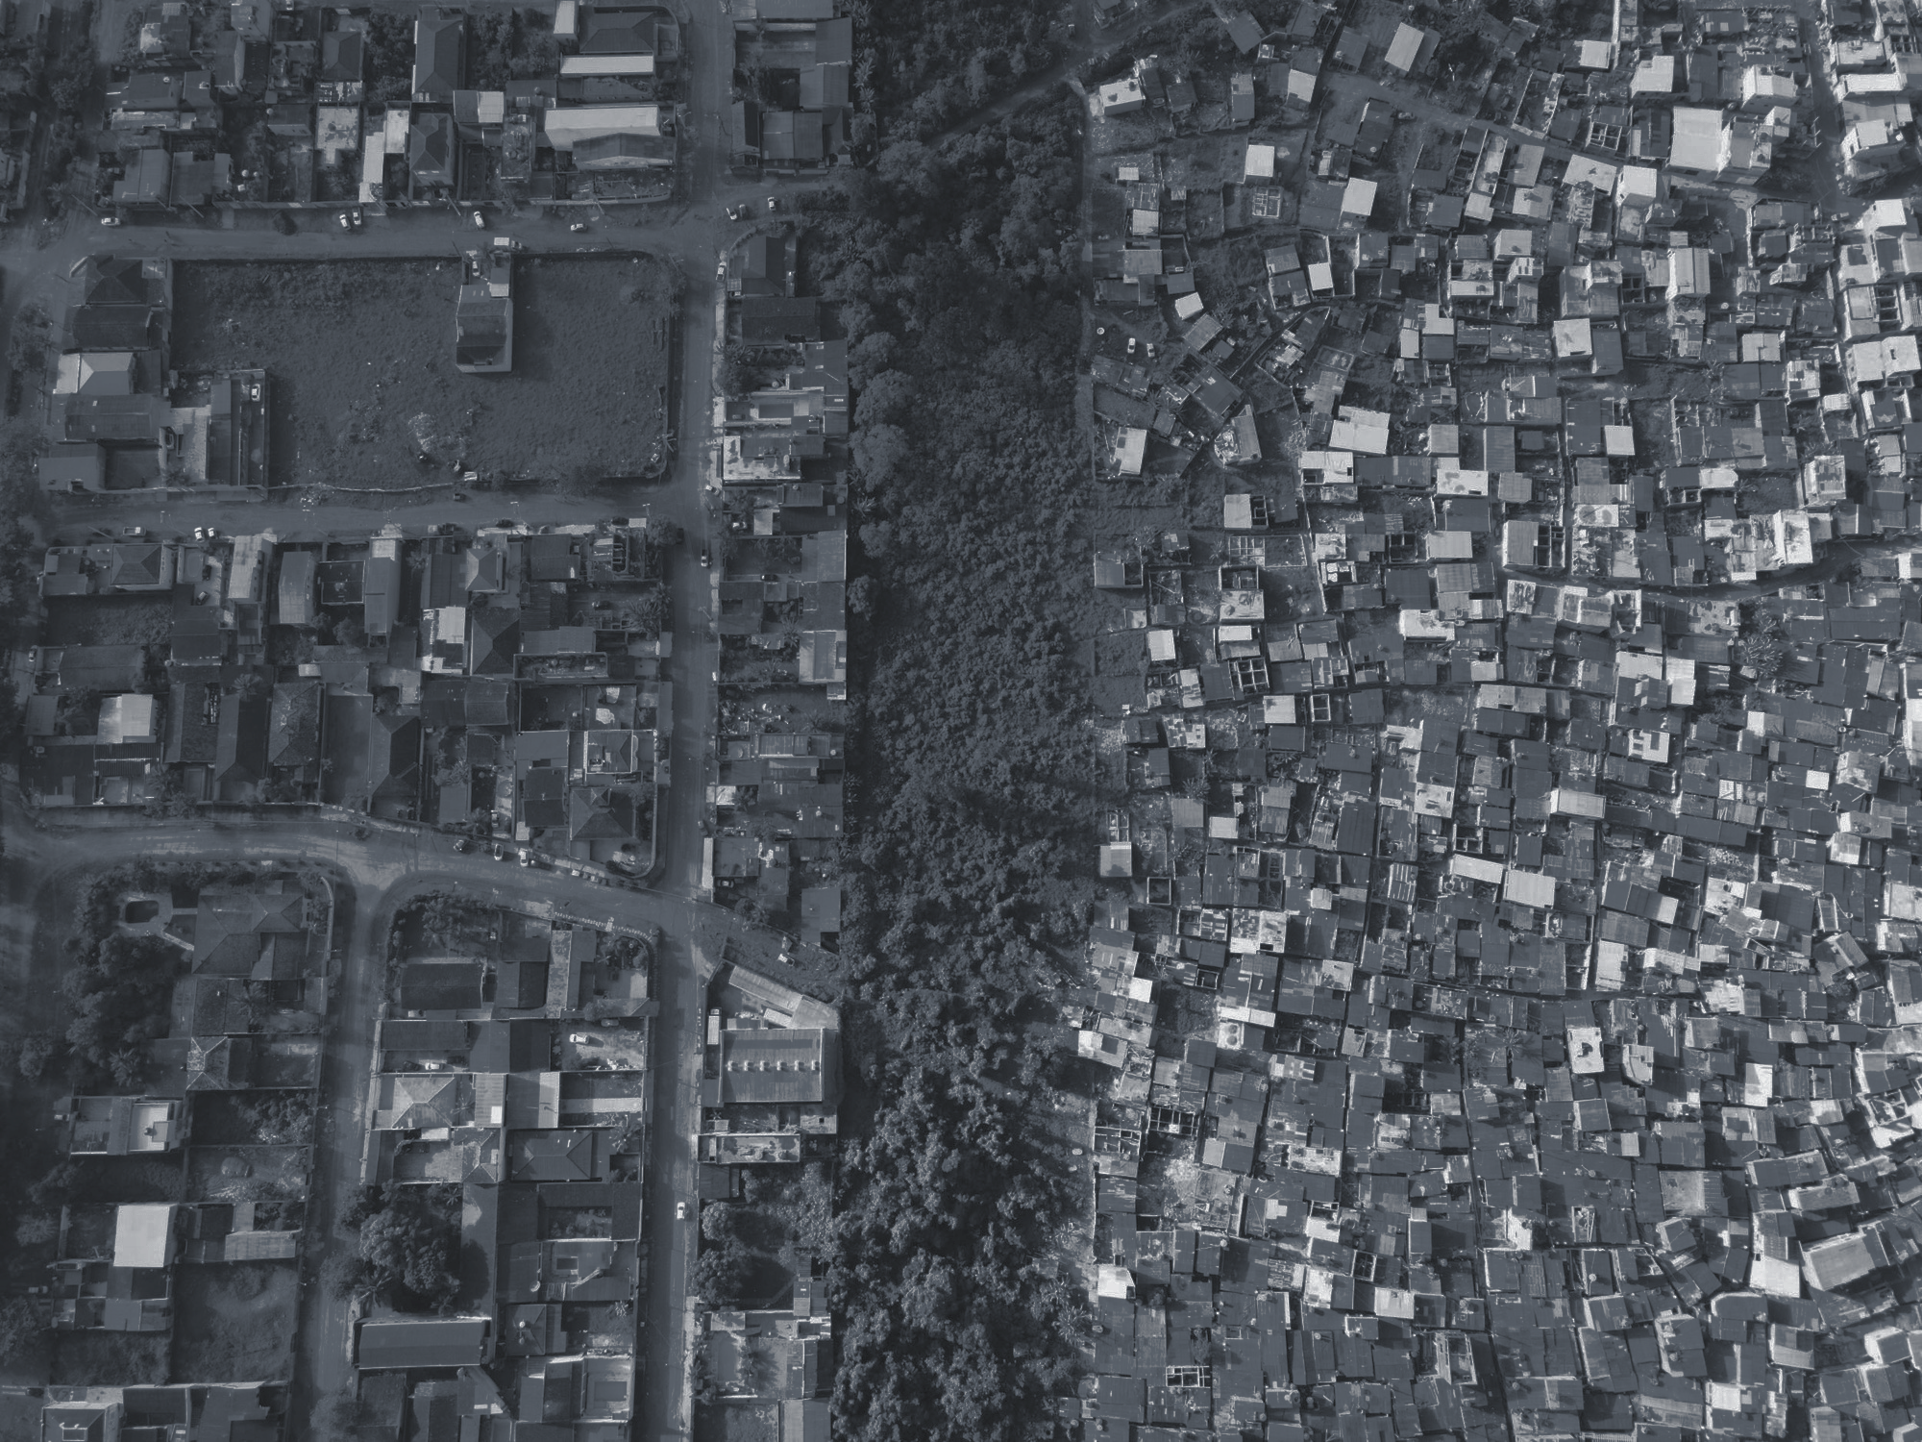

What inspired you to choose this challenge? Worldwide, disparity in neighborhood quality is a multifaceted, complex challenge.
The first step to solving any complex challenge is having a rich source of data to form and test hypotheses against.
Drones And Satellites provide the perfect medium for the needed data.

Slide 5
Our Solution Reform

Slide 6
What does it solve? A lack of unified source for data that incentivizes change towards more equal, accessible urban planning

Slide 7
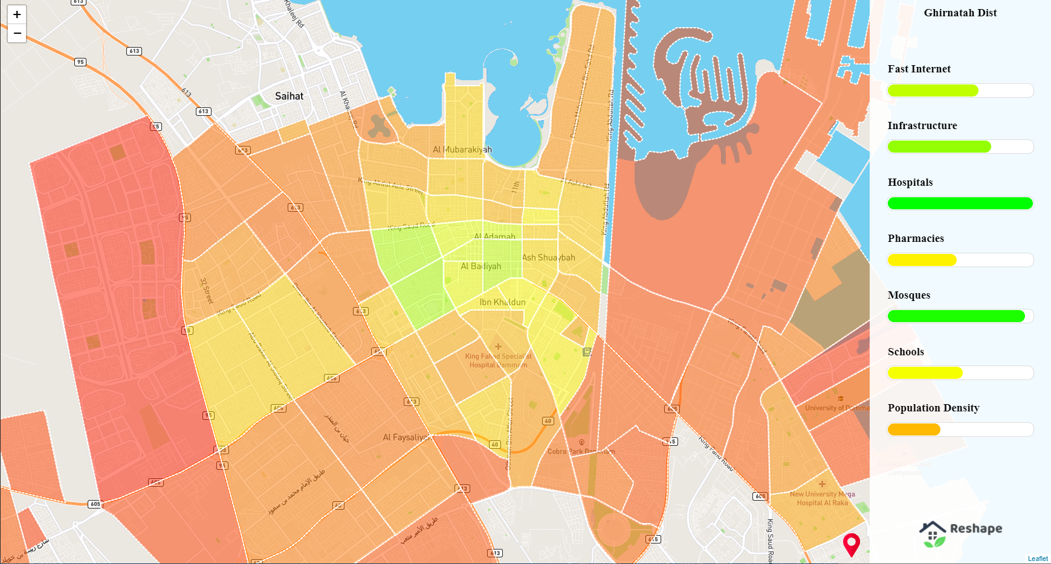
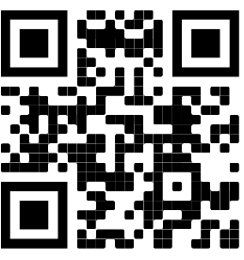
Try it!
Indicator color visualizes specific index value
District color shows quality of life aggregated index
Click on district to display the indicators on the right
https://reshape.duckdns.org/
Notes:
Indicators colors shows the quality of the necessities in the districts
Click on district to display the indicators on the rightIndicators colors shows the quality of the necessities in the districts
Click on district to display the indicators on the right

Slide 8
How did using data provided by space apps make your solution possible?
Space partner agencies provide a valuable source of information about multiple indices that we use in our platform

Slide 9
What will your idea change? We envision a platform that can drive change towards urban planning that focuses on inclusiveness, accessibility and sustainability

